Slide 1


Matthew Winder
February 2022

Slide 2

Outline
Executive Summary
Introduction
Methodology
Results
Conclusion
Appendix

Slide 3
Executive Summary
In order to determine the price point of delivering a payload into orbit publicly available SpaceX launch data was used to develop predictive models which identified successful stage 1 booster landings using a variety of parameters including launch site, payload mass, orbit type and booster
Analysis was carried out using a combination of programmatic queries and interactive maps and dashboards
The most successful model generated from the data was a Decision Tree Classification model with a predictive accuracy of 88.8889%
Assuming that the price of launch with a successful landing is $62m, the price without landing is $165m, and that SpaceY will only target launches with a successful landing, there is a mean launch price of $76.11m

Slide 4
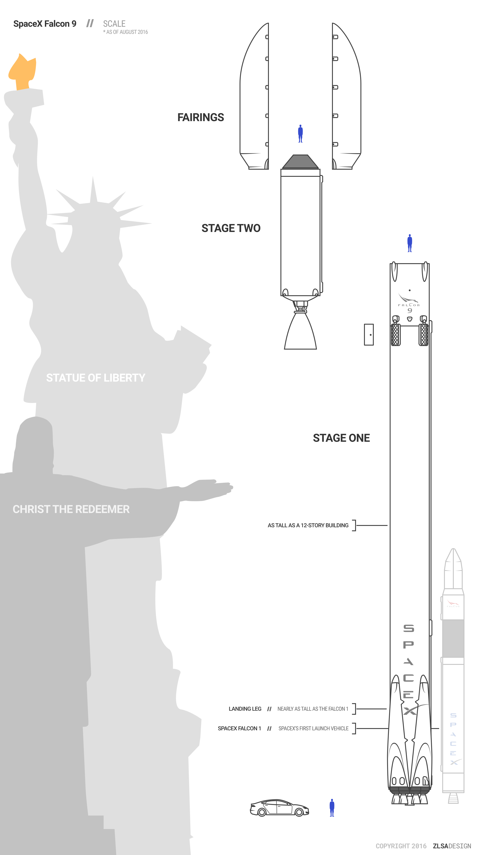
Introduction – Scenario
The commercialization of space travel is becoming viable with several organisations such as SpaceX, Virgin Galactic, Rocket Lab and Blue Origin, now providing payload delivery to customers
SpaceY, founded by entrepreneur Allon Mask, is looking to join this industry
Pricing from the industry incumbents ranges from ~$62m to ~ $165m with the costs heavily dependent on the reuse/functional recovery of the stage 1 booster

Slide 5
Introduction – Problem Statement
SpaceY wishes to find a commercially viable price point to enter the industry
Assuming that they will be able to produce rockets with approximately the same basic cost as SpaceX they need to determine the cost of a given launch
The cost of a launch is highly dependent on reuse of stage 1, so our analysis will focus on understanding the launch factors that contribute to a successful landing
Our prediction of success will be based on models generated and tested on the publicly available SpaceX flight and landing data

Slide 6


Slide 7
Methodology
Executive Summary
Data collection methodology:
Data for the investigation was collected through the SpaceX API and through web scraping a table from SpaceX’s Wikipedia page using the Requests and BeautifulSoup libraries
Perform data wrangling
Data was cleaned, categorical data was parameterized, and a classification item added to enable predictive analysis
Perform exploratory data analysis (EDA) using visualization and SQL
Perform interactive visual analytics using Folium and Plotly Dash
Perform predictive analysis using classification models
Data was standardized, split into training and testing sets, tuned using GridSearchCV, and multiple models evaluated for accuracy using score from Sklearn and visualized with confusion matrices

Slide 8
Data Collection
Data was collected for the investigation from:
the SpaceX data API (https://api.spacexdata.com), and
the Wikipedia page detailing launches of the Falcon 9 and Falcon Heavy (https://en.wikipedia.org/wiki/List_of_Falcon_9_and_Falcon_Heavy_launches)
The data items that were considered in the analysis were:
API: rocket, payload, launchpad, core, flight number, and date
Wikipedia: flight number, launch site, payload, payload mass, orbit, customer, launch outcome, version booster, booster landing, data and time

Slide 9
Data Collection – SpaceX API
Defined functions to extract enhanced rocket, payload, launchpad and core data
Decoded response content using .json()
Converted json data into a Pandas DataFrame using json_normalize()
Reduced the data items analysed
Filtered out multi-booster and payload launches
Reformatted the core, payload and date items
Captured enhanced rocket, payload, core and launchpad data using defined functions
Constructed combined dataset into a dictionary
Converted dictionary to Pandas DataFrame
Requested past launch data from SpaceX API
Filtered DataFrame to contain only Falcon 9 launches
Replaced nan PayloadMass values with the mean
Base SpaceX API: https://api.spacexdata.com
Enhancing data API calls:
https://api.spacexdata.com/v4/rockets/
https://api.spacexdata.com/v4/launchpads/
https://api.spacexdata.com/v4/payloads/
https://api.spacexdata.com/v4/cores/
API data items: rocket, payload, launchpad, core, flight number, and date
Completed SpaceX API calls notebook - GitHub

Slide 10
Data Collection - Scraping
Defined functions to extract key data items
Created a BeautifulSoup object from the response
Identified and captured the appropriate launch data table
Extracted column names by iterating through the table headers
Constructed a dictionary with keys from the column names and enhanced
Parsed data table into the launch_dict dictionary
Converted the dictionary to a Pandas DataFrame
Requested past launch data from Wikipedia page
Wikipedia page: https://en.wikipedia.org/wiki/List_of_Falcon_9_and_Falcon_Heavy_launches
Web scraping data items: flight number, launch site, payload, payload mass, orbit, customer, launch outcome, version booster, booster landing, data and time
Completed data collection with web scraping notebook - GitHub

Slide 11
Data Wrangling
Pandas DataFrame analysed for missing values and type
The number of landing outcomes were captured by raw type
Outcome types were classified as success or failure
Class column added to the DataFrame indicating outcome
A training classification (Class) of success as a single value was required
Where a mission outcome is “True” Class is set to 1
Mission Outcome mapping:
True ASDS, True RTLS, & True Ocean = 1
None None, False ASDS, None ASDS, False Ocean, False RTLS = 0
Completed data wrangling notebook - GitHub

Slide 12
EDA with Data Visualization
Exploratory Data Analysis was carried out to attempt to determine whether predictions could be made about the relationship with the following variables to a successful mission:
Payload mass, flight number (synonymous with time), launch site, and orbit type
Categorical data was then converted using One Hot Encoding to generate a feature set for further analysis
Scatter charts of flight number vs payload mass, flight number vs launch site, and payload mass vs launch site, flight number vs orbit type and payload vs orbit type were plotted to determine correlation between factors
A bar chart of orbit type success and a line graph of the yearly success trend were also plotted as independent signals
Completed EDA with data visualization notebook - GitHub

Slide 13
EDA with SQL
Exploratory Data Analysis was carried out through the following SQL queries on the data set:
Distinct sites used during the period
Total payload mass carried for NASA
Average payload mass carried by the F9 v1.1 booster
First successful ground pad mission was launched
Successful boosters landed on a drone ship with a payload mass between 4,000 and 6,000kgs
Total number of successfully completed and failed missions
Booster versions which have carried the maximum payload mass
Booster versions with failed drone ship landings in 2015
Ranked the landing outcome frequency between 2010-06-04 and 2017-03-20
Completed EDA with SQL notebook - GitHub

Slide 14
Build an Interactive Map with Folium
The following objects were added to an interactive Folium map to aid analysis of location as a factor to success and required considerations of environment:
Circles and Markers to indicate the location of the launch sites
A line showing the location of the equator relative to the sites
Launch outcomes (success or failure) as a cluster to each launch site
Lines and Markers showing the launch site distance to the following items:
Coastline – Useful for parts transport and safety in case of launch/landing failure
Railway and main road – Useful for parts and ground crew transport
Nearest city – To ensure that debris does not harm civilians
Completed interactive Folium map notebook - GitHub

Slide 15
Build a Dashboard with Plotly Dash
A dashboard was created with the following charts:
a pie chart to measure the launch success rates per site, and
a scatter plot displaying the correlation between success and payload mass
both graphics were filterable to display at a more granular level
The pie chart was added to provide a general indication of success rates, with the scatter plot added to meet the need for more detailed analysis across payload levels
Completed Plotly Dash lab notebook – GitHub

Slide 16
Predictive Analysis (Classification)
4 models were created from the SpaceX dataset seeking to determine the best predictor of landing success (Classification)
Data was imported, standardised and split into training and test data sets, and then tested with multiple models, each of which were refit for the best performing hyperparamenter
The methods assessed were Logistic Regression, Support Vector Machine, Decision Tree Classifier, and K Nearest Neighbours
Rerunning the notebook multiple times often returns an equal level of accuracy for all methods, however, where there is a different the method with the best performance is Decision Tree Classifier

Slide 17
Predictive Analysis (Flow Chart)
Imported SpaceX results data set
Separated the Classification (results) data
Imported SpaceX One-Hot Encoded data set
Standardised the One-Hot Encoded data set (StandardScaler)
Separated data into training and testing sets (train_test_split)
Determined best hyperparamers for models (GridSearchCV)
Fit and scored all models
Generated a Confusion Matrix for all models
Identified best model from score (Decision Tree Classifier)
Completed predictive analysis lab - GitHub

Slide 18
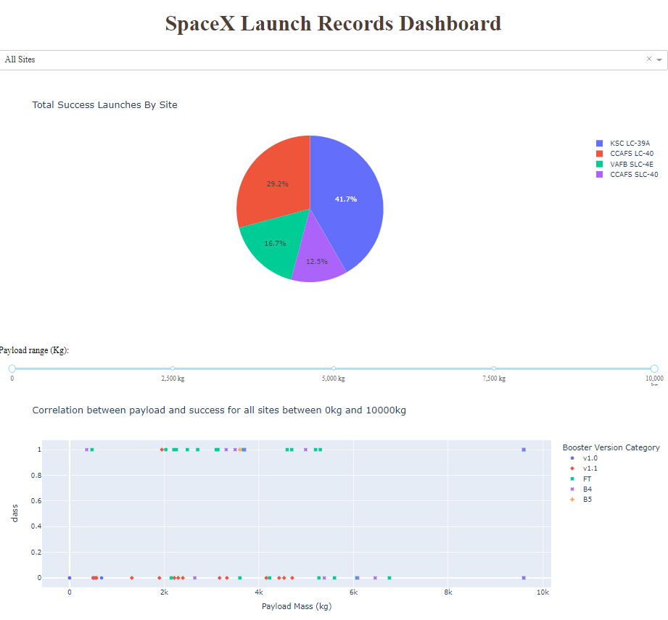
Results
The slides in the following sections outline:
Exploratory data analysis results
Interactive analytics demo in screenshots
Predictive analysis results

Slide 19


Slide 20
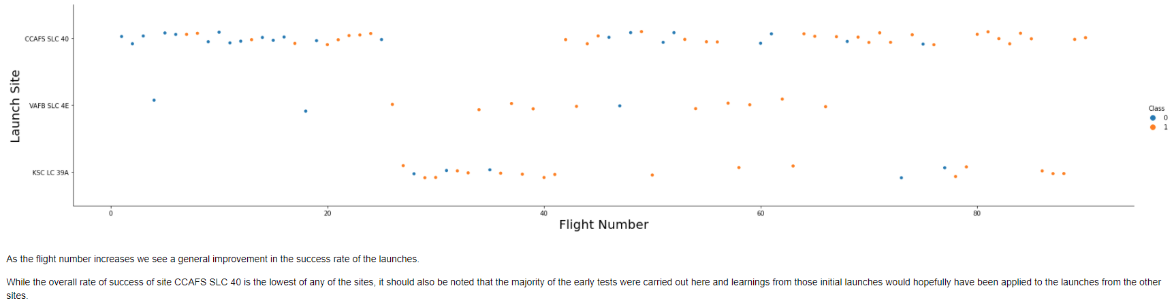
Flight Number vs. Launch Site

Slide 21
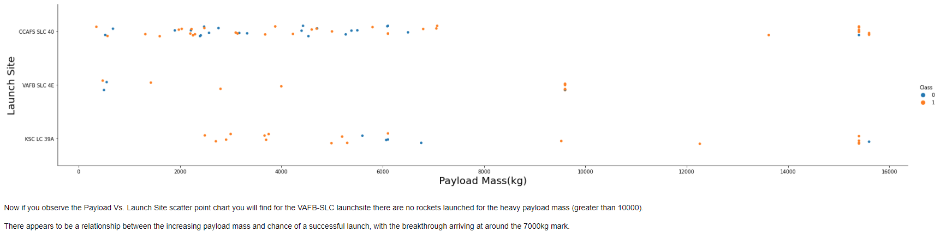
Payload vs. Launch Site

Slide 22
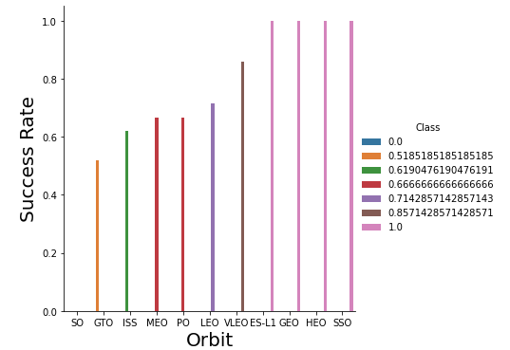
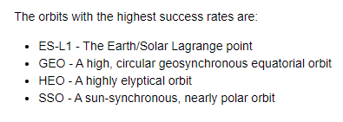
Success Rate vs. Orbit Type

Slide 23
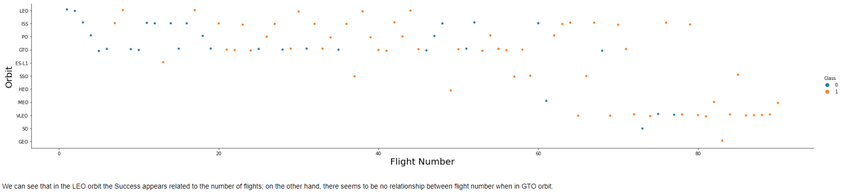
Flight Number vs. Orbit Type

Slide 24
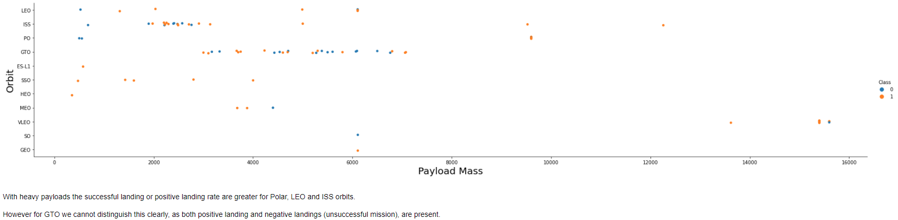
Payload vs. Orbit Type

Slide 25
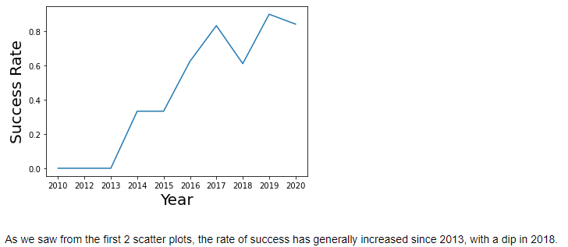
Launch Success Yearly Trend

Slide 26
Section 3
Insights drawn from SQL

Slide 27
All Launch Site Names
There are 4 unique launch sites:
CCAFS LC-40, CCAFS SLC-40, KSC LC-39A and VAFB SLC-4E
These were identified from the SpaceX DataSet using the following query: select distinct(launch_site) from SPACEXTBL
This query is using the distinct statement to return a list of unique values from the launch_site column of the SPACEXTBL table which contains the SpaceX DataSet data

Slide 28
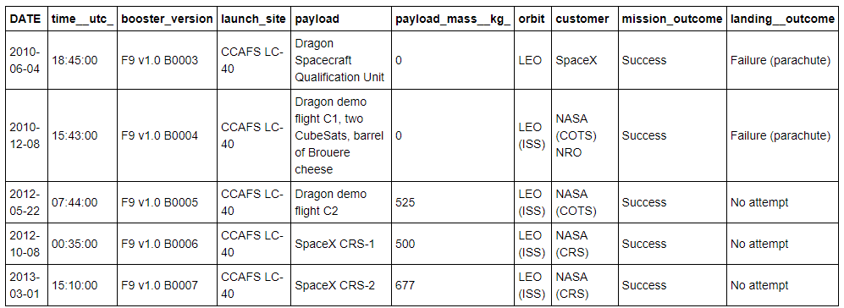
Launch Site Names Begin with 'CCA'
5 records where launch sites begin with `CCA`
select * from SPACEXTBL - select all records from the SpaceX DataSet where launch_site like 'CCA%’ - use the % wildcard after CCA to allow for different values LIMIT 5 - return only the first 5 results to meet the criteria

Slide 29
Total Payload Mass
The total payload carried by NASA (CRS) boosters was 45,596 kg
This was identified from the SpaceX DataSet using the following query: select sum(payload_mass__kg_) from SPACEXTBL where customer = 'NASA (CRS)'
This query is using the sum function to sum all values in the payload_mass_kg_ column of the SPACEXTBL table which was filtered on the customer with the name of NASA (CRS)

Slide 30
Average Payload Mass by F9 v1.1
The average payload mass carried by booster version F9 v1.1 was 2,928 kg
This was identified from the SpaceX DataSet using the following query:
select avg(payload_mass__kg_) from SPACEXTBL where booster_version like 'F9 v1.1'
This query uses the avg function to find the mean of all payload mass values which were filtered by the booster version matching F9 v1.1

Slide 31
First Successful Ground Landing Date
The first successful landing outcome on ground pad was December 22nd 2015
This was identified from the SpaceX DataSet using the following query:
select min(date) from SPACEXTBL where landing__outcome like 'Success (ground pad)'
This query uses the min function to select the first (smallest) date which was filtered by the landing outcome of 'Success (ground pad)'

Slide 32
Successful Drone Ship Landing with Payload between 4,000 and 6,000 kg
The following boosters have successfully landed on the drone ship and had a payload mass greater than 4,000 kg but less than 6,000 kg:
F9 FT B1022, F9 FT B1026, F9 FT B1021.2 and F9 FT B1031.2
These were identified from the SpaceX DataSet using the following query:
select distinct(booster_version) from SPACEXTBL where payload_mass__kg_ between 4000 and payload_mass__kg_ < 6000 and landing__outcome like 'Success (drone ship)'
This query uses the between keyword to select the payload mass range for the distinct 'Success (drone ship)' landing outcomes

Slide 33
Total Number of Successful and Failure Mission Outcomes
There was 1 failed mission outcome, 99 successful mission outcome, with 1 mission successful, but with an unclear payload status
This was identified from the SpaceX DataSet using the following query:
select count(mission_outcome),mission_outcome
from SPACEXTBL
group by mission_outcome
This query uses the count aggregation method and has been grouped by the mission outcome with the outcome included to aid display

Slide 34
Boosters Carried Maximum Payload
The following boosters have carried the maximum payload mass:
F9 B5 B1048.4, F9 B5 B1048.5, F9 B5 B1049.4, F9 B5 B1049.5, F9 B5 B1049.7, F9 B5 B1051.3, F9 B5 B1051.4, F9 B5 B1051.6, F9 B5 B1056.4, F9 B5 B1058.3, F9 B5 B1060.2, F9 B5 B1060.3
This was identified from the SpaceX DataSet using the following query:
select distinct(booster_version)
from SPACEXTBL
where payload_mass__kg_ =
(select max(payload_mass__kg_) from SPACEXTBL)
order by booster_version
This query uses a subquery to determine the maximum value of the payload mass, then uses that value to determine which boosters carried that mass

Slide 35
2015 Launch Records
The following are the failed landing_outcomes in drone ship, their booster versions, and launch site names for in year 2015:
These were identified from the SpaceX DataSet using the following query:
select date, landing__outcome, booster_version, launch_site
from SPACEXTBL
where year(date) = 2015
and landing__outcome like 'Failure (drone ship)'
This query uses the year function with the date field to return only those results from 2015
DATE | landing__outcome | booster_version | launch_site
2015-01-10 | Failure (drone ship) | F9 v1.1 B1012 | CCAFS LC-40
2015-04-14 | Failure (drone ship) | F9 v1.1 B1015 | CCAFS LC-40

Slide 36
Rank Landing Outcomes Between 2010-06-04 and 2017-03-20
The table below shows the frequency of the landing outcomes between June the 4th 2010 and March the 20th 2017 in descending order:
This was identified from the SpaceX DataSet using the following query:
select landing__outcome as "Landing Outcome", count(landing__outcome) as "Count" from SPACEXTBL where date between '2010-06-04' and '2017-03-20' group by landing__outcome order by 2 desc
This query again makes use of the between keyword to specify the date range; the grouping is by the landing outcome; and we rank the frequency referring to the aggregate column by number in the result set (2).
Landing Outcome | Count
No attempt | 10
Failure (drone ship) | 5
Success (drone ship) | 5
Controlled (ocean) | 3
Success (ground pad) | 3
Failure (parachute) | 2
Uncontrolled (ocean) | 2
Precluded (drone ship) | 1

Slide 37


Slide 38
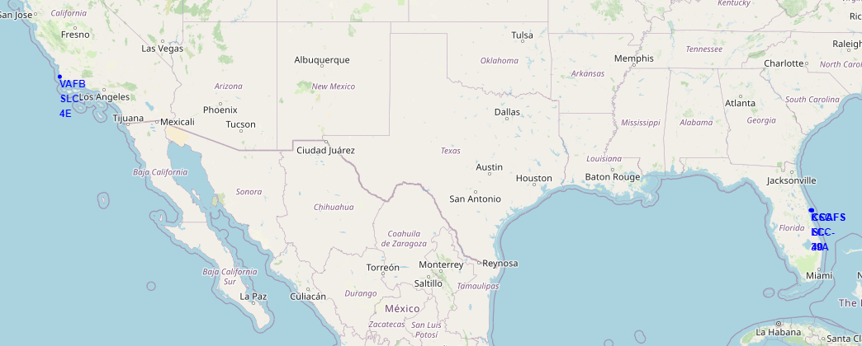
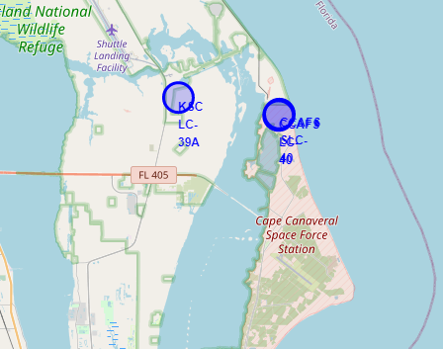
Launch Site Locations
The image above shows all launch site locations, with the image on the right expanded to show the eastern sites which are in close proximity to each other
Notice that all sites are practically on the coast and as close to the equator as possible

Slide 39
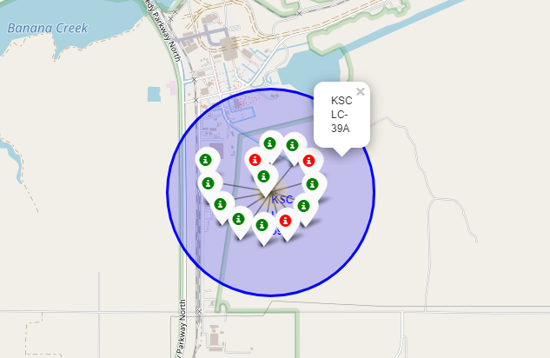
Successful Site Launches – KSC LC-39A
This image provides a graphical representation of the launch successes for site KSC LC-39A
Successful launches are marked in green, with failed launches marked in red

Slide 40
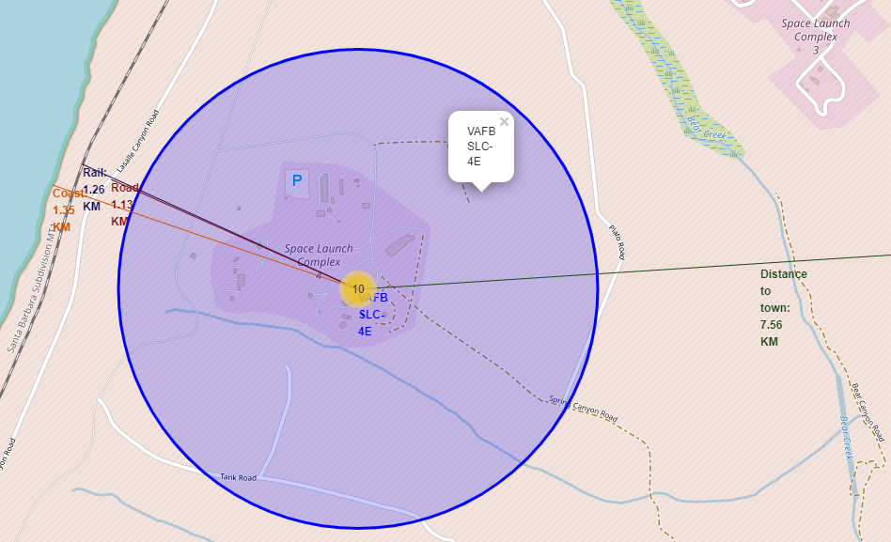
Distances to Items of Interest
This image gives distances to several close points of reference including the coast, a road and a railway line
The nearest town is far enough away that to include more than a reference to its location would render the other items illegible

Slide 41


Slide 42
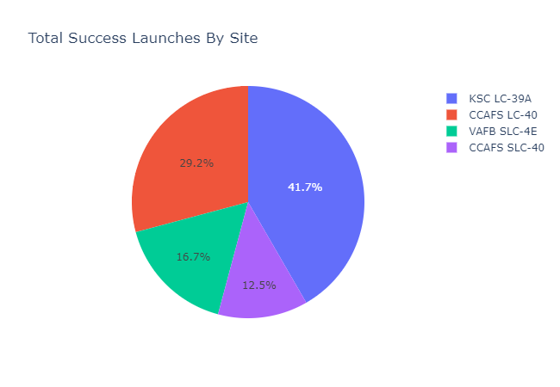
SpaceX Successful Launch % Per Site
The figure opposite shows the successful launches by site as a % of total launches made during the period
Three obvious limitations of this data are:
We do not know how many launches were made per site
The payload mass for each of the launches (determined later)
The date of each of the launches (later launches are typically more successful)

Slide 43
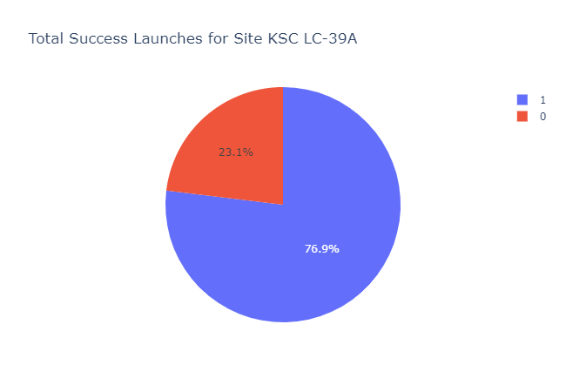
Successful Launch Ratio For Site KSC LC-39A
Of the 4 sites, KSC LC-39A had the highest individual successful launch rate with 76.9%
The figure opposite shows the breakdown by class with a 1 representing a successful launch

Slide 44
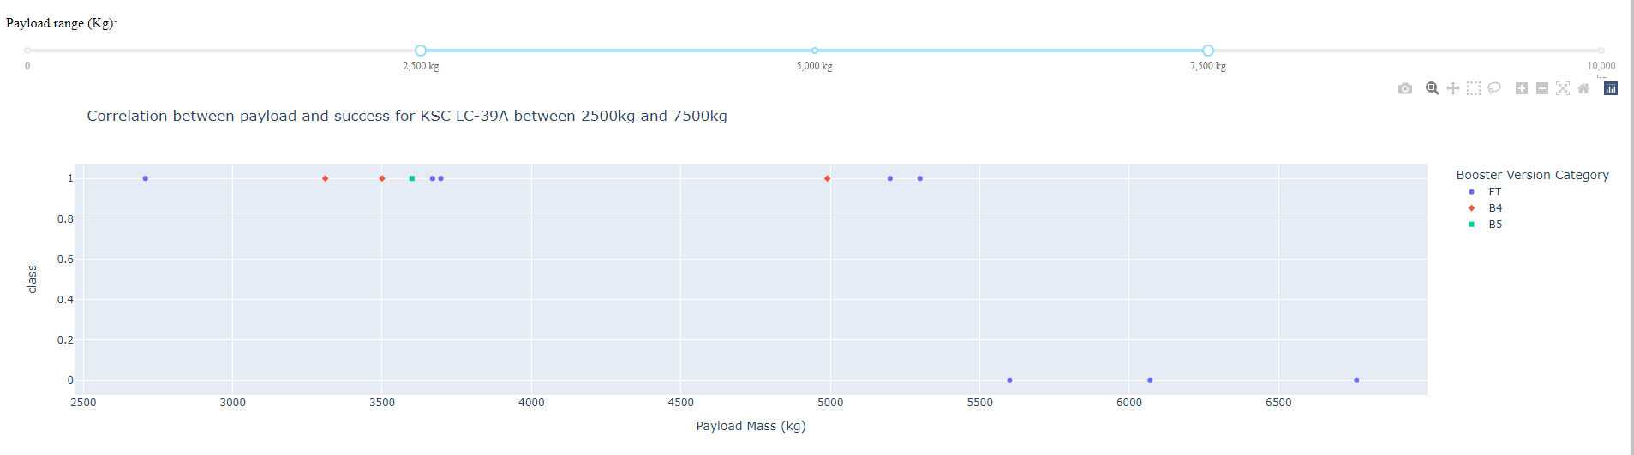
Analysis of Payload vs Success For Site KSC LC-39A
The figure above shows the correlation of the payload mass to the success for site KSC LC-39A which has been taken from an interactive scatter graph generated using Plotly Dash
As can be seen, the most successful payload mass for launches from the site during the period is between 2,500kg and 5,500kg

Slide 45


Slide 46
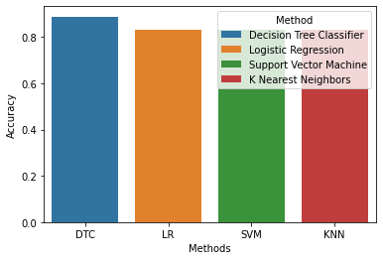
Classification Accuracy
It should be noted that we only have a small number of test samples which likely gives rise to the variability between runs
Where there is a most accurate model it is typically the Decision Tree Classifier that returned the highest accuracy, in this instance at 88.8889%

Slide 47
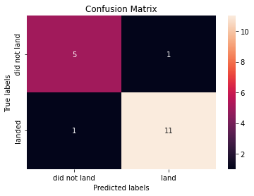
Confusion Matrix (DTC)
The correct predictions are on the diagonal from top-left to bottom-right
5 of the 6 failed landings were correctly identified along with 11 of the 12 successful landings
The other models all predicted a surplus of positive landings

Slide 48
Conclusions
SpaceY wishes to find a commercially viable price point to enter the industry
Assuming that they will be able to produce rockets with approximately the same basic cost as SpaceX they need to determine the cost of a given launch
With the data available for modeling and the techniques used, there is an 88.8889% prediction rate of landing success based on the most accurate predictive model (DCT)
Assuming that the price of launch with a successful landing is $62m, the price without landing is $165m, and that SpaceY will only target launches with a successful landing, there is a mean launch price of $76.11m
Orbit type appears to display a more significant correlation with successful recovery than other factors. This is impacted by the nature of the payload (observation craft, satellite, ISS mission), and may inform a more granular pricing model
This is a limited data set so a larger number of iterations than used during this analysis may be beneficial for further investigation if no further data can be gathered
Launch sites need to be near a large body of water, a railway line and/or a major highway, and a reasonable distance from cities for safety

Slide 49
Appendix
This presentation has been generated as part of the IBM Data Science Professional Certificate and has used the following resources:
SpaceX API – https://api.spacexdata.com
SpaceX Wikipedia page – https://en.wikipedia.org/wiki/List_of_Falcon_9_and_Falcon_Heavy_launches
Infographic by https://zlsadesign.com/
All slides, notebooks and data sources are held at https://github.com/matthewrwinder/LaunchSites/tree/master

Slide 50


